Slide 1
FULL STACK WEB DEVELOPMENT UNIT – 4 APP Development Using Angular

Slide 2
Angular
Angular (formerly called Angular JS) is a typescript based web application framework that supports full-stack development for building all types of web applications.
Angular is owned by Google, and its stable version was released on September 14, 2016. Angular's official website is https://angular.io/. Google makes sure that they release a major version of Angular every 6 months.
It helps in creating reactive single page application (SPA) and is completely based on the concept of components
As a platform, Angular includes:
A component-based framework for building scalable web applications
A collection of well-integrated libraries that cover a wide variety of features, including routing, forms management, client-server communication, and more
A suite of developer tools to help you develop, build, test, and update your code

Slide 3
What is Single Page Application(SPA)?
Single-page applications are web applications or a special type of website that provide users with a very intuitive, responsive, and fast user experience. It is enriched with menus, multiple blocks, tiles, and interactive buttons on one page, helping users easily navigate the application. This helps to dynamically load a portion of the current page instead of reloading the entire page from the server. This is why angular based applications are called reactive fast speed loading pages.
What is Angular CLI?
Angular CLI is basically a command-line interface tool that automates the application development process by initializing new Angular applications and maintaining them directly from a command shell.

Slide 4
Angular Features
1)Angular supports multiple platforms:
Desktop applications
Native applications
Progressive web applications
2)High Speed, Ultimate Performance:
Universal support
Code splitting
Code generation
3)Productivity:
Powerful templates
IDEs
Angular CLI
4) Full Stack Development:
Testing
Animation Support
Accessibility

Slide 5
Angular1 was initially released in 2010. It was the first Angular version. It created a revolution in the web application development. It was a browser side JavaScript which was used within HTML code. It is popularly known as AngularJS.
Angular2 was a complete rewrite of Angular1. It was initially released in 2016. There is nothing common between Angular2 and Angular1 except the core developer's team. Angular2, Angular 6 and Angular 7 are very similar to each other. Angular 7 is the latest version. It contains the extensive features of Angular2 and Angular6. These versions are known as Angular.

Slide 6
Difference between AngularJS and Angular
AngularJS | Angular
AngularJS is common and popular name of the first version of Angular1.0. | Angular is common and popular name of the Angular's version beyond 2+
AngularJS is a JavaScript-based open-source front-end web framework. | Angular is a TypeScript-based open-source full-stack web application framework.
AngularJS uses the concept of scope or controller. | Instead of scope and controller, Angular uses hierarchy of components as its primary architectural characteristic.
AngularJS has a simple syntax and used on HTML pages along with the source location. | Angular uses the different expression syntax. It uses "[ ]" for property binding, and "( )" for event binding.
AngularJS is a simple JavaScript file which is used with HTML pages and doesn't support the features of a server-side programming language. | Angular uses of Microsoft's TypeScript language, which provides Class-based Object Oriented Programming, Static Typing, Generics etc. which are the features of a server-side programming language.
AngularJS doesn't support dynamic loading of the page. | Angular supports dynamic loading of the page.

Slide 7
Setting up the local environment and workspace
Install the Angular CLI
we use the Angular CLI to create projects, generate application and library code, and perform a variety of ongoing development tasks such as testing, bundling, and deployment.
To install the Angular CLI, open a terminal window and run the following command:
npm install -g @angular/cli
Create a workspace and initial application
We develop apps in the context of an Angular workspace.
To create a new workspace and initial starter app: Run the CLI command ng new and provide the name my-app, as shown here: ng new my-app

Slide 8
The ng new command prompts you for information about features to include in the initial app. Accept the defaults by pressing the Enter or Return key.
The Angular CLI installs the necessary Angular npm packages and other dependencies. This can take a few minutes.
The CLI creates a new workspace and a simple Welcome app, ready to run.

Slide 9
Run the application:
The Angular CLI includes a server, so that you can build and serve your app locally.
Navigate to the workspace folder, such as my-app
Run the following command:
cd my-app
ng serve --open
The ng serve command launches the server, watches your files, and rebuilds the app as you make changes to those files.
The –open or –o option automatically opens your browser to http://localhost:4200/

Slide 10
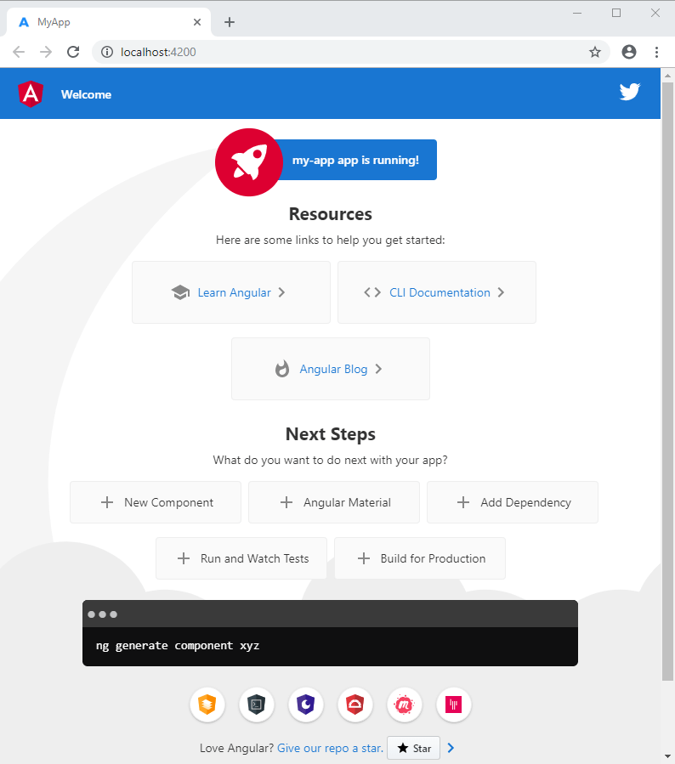

Slide 11
Components
Components are the building blocks that compose an application. A component includes a TypeScript class with a @component() decorator, an HTML template, and styles.
The @component() decorator specifies the following Angular-specific information:
A CSS selector that defines how the component is used in a template. HTML elements in your template that match this selector become instances of the component.
An HTML template that instructs Angular how to render the component.
An optional set of CSS styles that define the appearance of the template's HTML elements.

Slide 12
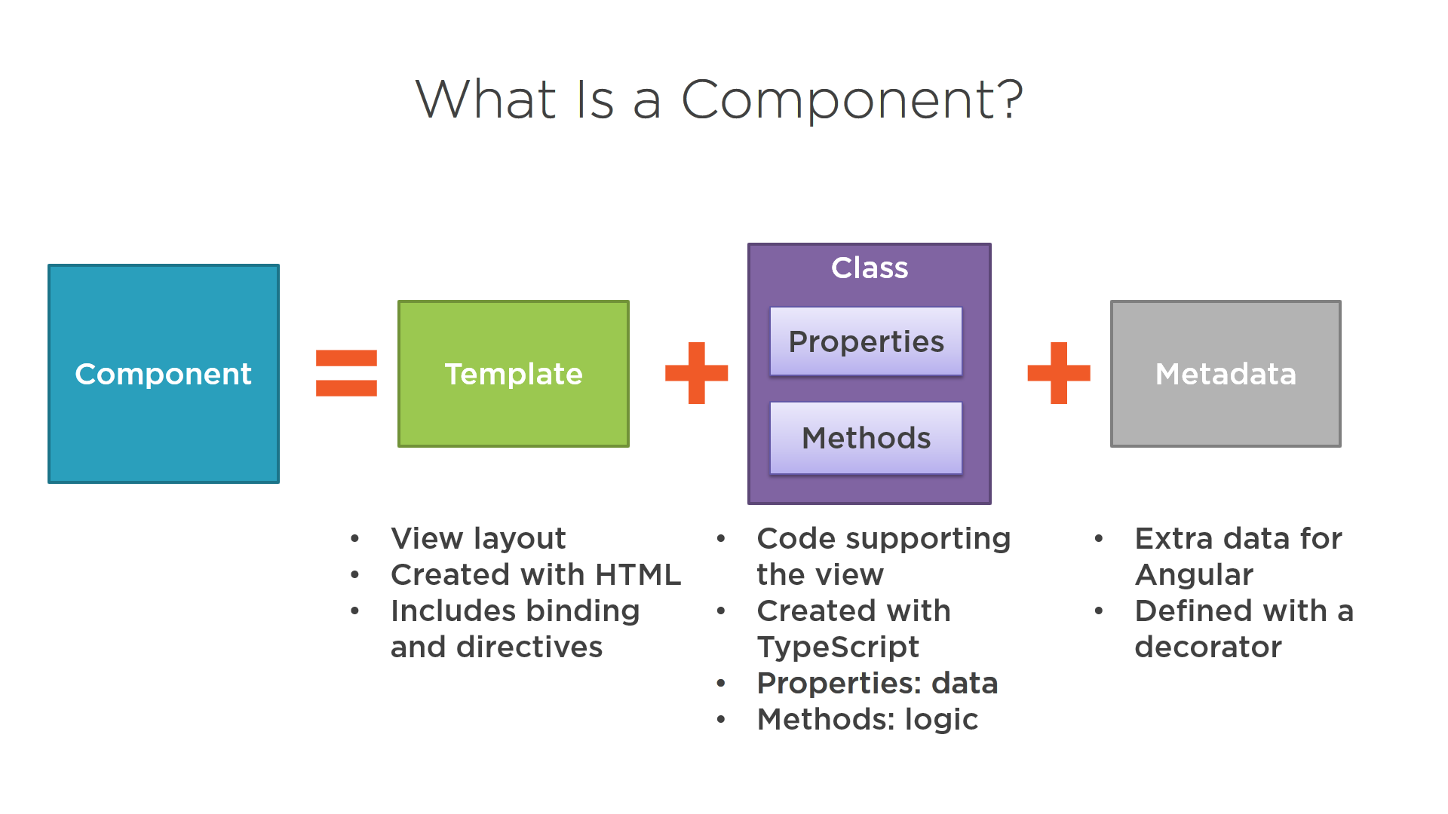

Slide 13
Creating component with CLI
Syntax:
ng generate component component_name
Or
ng g c component_name
By default, this command creates the following:
A folder named after the component
A component file, <component-name>.component.ts
A template file, <component-name>.component.html
A CSS file, <component-name>.component.css
A testing specification file, <component-name>.component.spec.ts

Slide 14
Events and Binding with ngModel
What is Data Binding?
Data Binding is the mechanism that binds the applications UI or User Interface to the models. Using Data Binding, the user will be able to manipulate the elements present on the website using the browser. Therefore, whenever some variable has been changed, that particular change must be reflected in the Document Object Model or the DOM.
Types of Data Binding in Angular:
Angular allows both One-way and Two-way Data Binding. One-way data binding is a simple type of data binding where you re allowed to manipulate the views through the models. This implies, making changes to the Typescript code will be reflected in the corresponding HTML.
1. One-way Data Binding
2. Two-way Data Binding

Slide 15
One-way Data Binding
Definition: In one-way data binding, data flows only in one direction i.e from the models to the views. As mentioned earlier, one-way data binding in Angular can be divided into many types
Interpolation or String Interpolation
Property binding
Event binding
Class binding
Style binding
Notes:
b

Slide 16

Interpolation Binding
Definition: Interpolation is a procedure that allows the user to bind a value to the user interface element. Interpolation binds the data one-way, which means that data moves in one direction from the components to HTML elements.
Syntax:
{{ templateExpression }}
Example:
<h1>{{title}}</h1>
Learn <b> {{course}}
</b> with CMRIT
2 * 2 = {{2 * 2}}

Slide 17
The Typescript part of this code is as follows:
1 2 3 4 5 | export class AppComponent { title = 'Databinding'; course ='Angular'; }

Slide 18
Property Binding
Property binding is a one-way data binding mechanism that allows you to set the properties for HTML elements. It involves updating a property value in the component and binding the value to an HTML element in the same view. We use property binding for toggle functionality and sharing data between components. It uses the "[]" syntax for data binding.
Syntax:
[binding-target]=”binding-source”
Example1): app.component.html
<input type="text" [disabled]="isDisabled">
App.component.ts
isDisabled=true;
Example 2): app.component.html
<input type="text" [value]= "name" [disabled]="isDisabled">
App.component.ts
name=“priya";
isDisabled=true;

Slide 19
What is the difference between interpolation and property binding?
Interpolation | Property Binding
It can be implemented using {}. | It can be implemented with [].
It supports the concatenation of string inside a variable. | Property Binding does not support the concatenation of String.
Interpolation does not support working with a boolean type. | Property Binding supports working with all boolean types.

Slide 20
Event Binding
Events are actions like mouse click, double click, hover or any keyboard and mouse actions. If a user interacts with an application and performs some actions, then event will be raised. It is denoted by either parenthesis () or on-. We have different ways to bind an event to DOM element.
The Event binding feature lets you listen to certain events such as mouse movements, keystrokes, clicks, etc. In Angular, event binding can be achieved by specifying the target event name within regular brackets on the left of an equal to ( = ) sign, and the template statement on the right side within quotes (” “).
Events are handled in Angular using the following special syntax:
(target event name) = "template statement"
Bind the target event name within parentheses on the left of an equal sign, and event handler method or statement on the right.

Slide 21
1) Example: Binding Button Click Event
<button (click)="onShow()">Show</button>
Above, (click) binds the button click event and onShow() statement calls the
onShow() method of a component.
Example: Handle Button Click Event In Component
@Component({
selector: 'event-demo,
template: '<button (click)="onShow()" >Show</button>'
})
export class EventBindingDemoComponent implements OnInit {
constructor() { }
ngOnInit(): void {
}
onShow()
{
alert('Show button clicked!'); } }

Slide 22
Alternatively, use the on- prefix, known as the canonical form:
Example: on-event
<button on-click="onShow()" >Show</button>
By default, an event propagates up to the parent container event. In the following example, click event propagates to click of div and will call both the onShow(),onDivClick() methods.
Example: Event Bubbling
<div (click)="onDivClick()">
<button (click)="onShow()" >Show</button> </div>

Slide 23
$event:
Mostly, when an event is raised, you may need to pass some value to the event handler function. This value can be number, string, or an object that contains information about an event.
We can pass the number or string value to the event handler function, as shown below.
Example: Passing Event Data <button (click)="onShow(20)">Show</button>
Angular includes $event that contains the information about an event. The type of $event depends on the target event, e.g., if the target event is a native DOM element event, then it is an object.
Example: $event
<button (click)="onShow($event)">Show</button>
A component should define the onShow(event) method where the type of the parameter can be KeyboardEvent, MouseEvent, etc. If you don't know the exact event type, they use “any” type, as shown below.

Slide 24
Example: event Parameter
onShow(event:any) {
console.log(event);
}
If event is a native DOM element event then $event.target get DOM element reference using which you can access element's property e.g. $event.target.innerHTML returns the value of innerHTML property of a DOM element.
Example: Event Handling
<button (click)="onShow($event)">Show</button> //component method
onShow(event:any) { alert(event.target.innerHTML); // returns Show }

Slide 25
We can use $event.target in the template statement. The following example binds a component property to
$event.target.value of the input box on the input event without using ngModel
Example: Bind Event without ngModel
<input type="text" (input)="userName=$event.target.value"><br/> {{userName}}
Event binding another Example:
We have created a Subscribe button that displays a “Thank you” message when clicked on.
<br><button (click)="onClick()">Subscribe to Angular </button></div>
To display the message on the console, we’ve created a function called onClick() in the app.component.ts file.
onClick(){
console.log("Thanks for subscribing")
}
Every time the user clicks on the button, the message is displayed on the console.

Slide 26
Style Binding
It is very easy to give the CSS styles to HTML elements using style binding in Angular 8. Style binding is used to set a style of a view element. We can set the inline styles of an HTML element using the style binding in angular. You can also add styles conditionally to an element, hence creating a dynamically styled element.
Syntax: <element [style.style-property] = "'style-value'">
Example 1:
app.component.html:
<h1 [style.color] = "'green'"
[style.text-align] = "'center'" >
Angular
</h1>

Slide 27
Example 2: Setting the size of the font using style binding.
app.component.html:
<div [style.color] = "'red'"
[style.text-align] = "'center'"
[style.font-size.px]="'30'" >
Angular Application
</div>
Example 3: Conditional styling.
app.component.html:
<div [style.color]="status=='error' ? 'red': 'green'"
[style.text-align] = "'center'"
[style.font-size.px]="'24'" >
My Angular Application
</div
app.component.ts:
import { Component } from '@angular/core';
@Component({
selector: 'app-root',
templateUrl: './app.component.html',
styleUrls: ['./app.component.css']
})
export class AppComponent {
status = "All good";
}

Slide 28
Class Binding
Class binding in Angular makes it very easy to set the class property of a view element. We can set or remove the CSS class names from an element’s class attribute with the help of class binding.
We bind a class of a DOM element to a field that is a defined property in our Typescript Code. Its syntax is like that of property binding.
Syntax: <element [class] = "typescript_property">
Approach:
Define a property element in the app.component.ts file.
In the app.component.html file, set the class of the HTML element by assigning the property value to the app.component.ts file’s element.

Slide 29
Example 1: Setting the class element using class binding.
app.component.html:
<h1 [class] = “cmrit">
cmrit college</h1>
Upper Heading's class is : "{{ g[0].className }}"
app.component.ts
import { Component, OnInit } from '@angular/core';
@Component({
selector: 'app-root',
templateUrl: './app.component.html'
})
export class AppComponent {
cmrit = “cmritClass";
g = document.getElementsByClassName(this.cmrit);
}

Slide 30
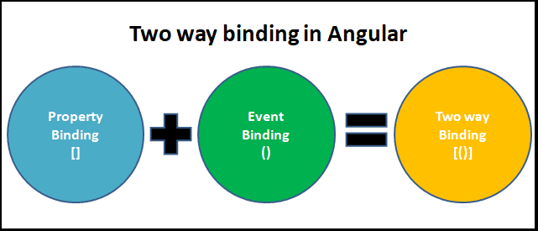
Two-way Binding
Angular allows two-way data binding that will allow your application to share data in two directions i.e. from the components to the templates and vice versa. This makes sure that the models and the views present in your application are always synchronized. Two-way data binding will perform two things i.e. setting of the element property and listening to the element change events.
The syntax of two way binding is – [( )]. As you can see, it is a combination of the property binding syntax i.e. [ ] and the event binding syntax ( ). According to Angular, this syntax resembles “Banana in a Box”

Slide 31
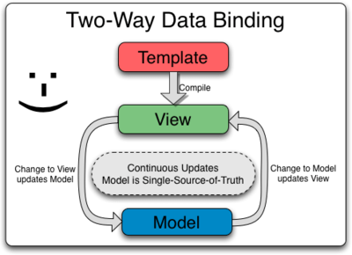

Slide 32
Two-way data binding is mainly used in data entry forms where the user changes the view and makes changes in the model with the view data and vice-versa. So, as we know, Angular uses the combination of Property binding and event binding to implement two-way data binding with the help of ngModel directive.

Slide 33
Two way binding without using ng model:
Example:
App.component.html:
<input type=“text” [value]=“text” (input)=“updateValue
($event)”>
App.component.ts:
updateValue(e){
this.text=e.target.value;
console.log(e.target.value);
}

Slide 34
What is ngModel
The Angular uses the ngModel directive to achieve the two-way binding on HTML Form elements. It binds to a form element like input, select, selectarea.
Internally It uses the ngModel in property, binding to bind to the value property and ngModelChange which binds to the input event.
How to use ngModel
NgModel is not a part of Angular's code library, it is defined in the forms module library so you need to import the FormsModule library in your app.module.ts file. Now we can use the ngModel directive to implement two-way data binding.
In the template use the following syntax:
<input type="text" name="value" [(ngModel)]="value">
The ngModel directive placed inside the square & parentheses . This is assigned to the Template Expression. Template Expression is the property in the component class

Slide 35
ngModel Example or Twoway binding with using ngModel
Import FormsModule
Open the app.module.ts and make the following changes .
import { FormsModule } from '@angular/forms';
Imports:[
BrowserModule,
FormsModule,
],
App.component.html:
<input type=“text” [[ngModel]]=“text”
{{text}}

Slide 36
Fetch Data From A Service
Angular offers HttpClient to work on API and handle data easily. In this approach HttpClient along with subscribe() method will be used for fetching data.
Step 1: Create the necessary component and application.
Step 2: Do the necessary imports for HttpClient in module.ts file.
import { HttpClientModule } from '@angular/common/http';
imports: [
HttpClientModule,
],
Step 3: Do the necessary imports for HttpClient in component.ts file.
import { HttpClientModule } from '@angular/common/http';
Step4: We get Response from API by passing API url in get() method and then subscribing to the url.
this.http.get('API url').subscribe(parameter)
The Response of the API is stored in a variable from which data can be accessed.

Slide 37
Step 5: Now data array need to be showed using HTML. A Table is used in which rows are added dynamically by the size of data array. For this, rows are created using *ng For then data is showed from each row.

Slide 38
Submit Data To Service
The ngSubmit() method is called when the ‘submit’ event is triggered on the ngForm.
Syntax
<form (ngSubmit)='method($event)'></form>
$event: the “submit” event object
Approach:
Create an Angular app that to be used.
In app.component.ts, make an array that takes the value from the form.
In app.component.html, make a form and send the value using (ngSubmit) method.
Serve the angular app using ng serve to see the output.

Slide 39
Http Module & Observables
Angular has inbuilt http module(Web Api) to communicate with backend and send or receive data via http methods like Get, Post, Put, Delete and all other http requests.
HttpClientModule
to perform http requests,
Import ‘HttpClientModule’ from ‘@angular/common/http’ in app.modules.ts.
HttpClient
create a separate typescript(service) file where in you perform all kinds of operations that interact with backend or getting data.
Create a service with the following command ‘ng g service data’.
Data.service.ts file will be created.
To perform a http operation you need to
import ‘httpclient’ module from ‘@angular/common/http’ in the respective services file.

Slide 40
Writing an operation in data.service.ts
In getting data from a certain endpoint and return it to components we use something called ‘Observables’ in angular. We use observable to observe certain data objects and subscribe to the data.
Call httpclient in Constructor and create a method for eg: getdata in which we return an observable.
That means we are performing a ‘get’ operation on a certain url or endpoint or backend and storing the data into the observable so that it can be subscribed in any component.
Calling the service in components.
Call the ‘getdata’ method and subscribe to the observable and assign it to any variable of data type any which you can further use in component’s HTML code and display in the browser.

Slide 41
Routing
Routing in AngularJS is used when the user wants to navigate to different pages in an application but still wants it to be a single page application.
AngularJS routes enable the user to create different URLs for different content in an application.
The ngRoute module helps in accessing different pages of an application without reloading the entire application.
$routeProvider is used to configure the routes. It helps to define what page to display when a user clicks a link. It accepts either when() or otherwise() method.
The ngRoute must be added as a dependency in the application module:
const app = angular.module("myApp", ["ngRoute"]);

